Slide 1
“Designing And Simulating Rover Through SOLIDWORKS”
UNIVERSITY COLLEGE OF ENGINEERING
Rajasthan Technical University, Kota
Major Project Presentation On
Presented By:-
Piyush Saxena (17/208)
Samarth Mittal (17/213)
Under the guidance of:-
Mr. Mohd. Shahid
Dept. of Aeronautical Engineering
Submitted to:-
Anshul Khandelwal
Dept. of Aeronautical Engineering

Slide 2
OUTLINE
INTRODUCTION
DESIGNING OF COMPONENTS
ASSEMBLY
SIMULATION
CONCLUSION
REFERENCES

Slide 3
INTRODUCTION
Rover
A rover is a planetary surface exploration device designed to move across the solid surface on a planet or other planetary-mass celestial bodies.
A rover can drive around to different areas, studying & search for the different chemicals in each rock and characterize a variety of rocks and soils that hold clues to past water activity.
Figure-1 NASA's Curiosity rover explores Mars's Gale Crater

Slide 4
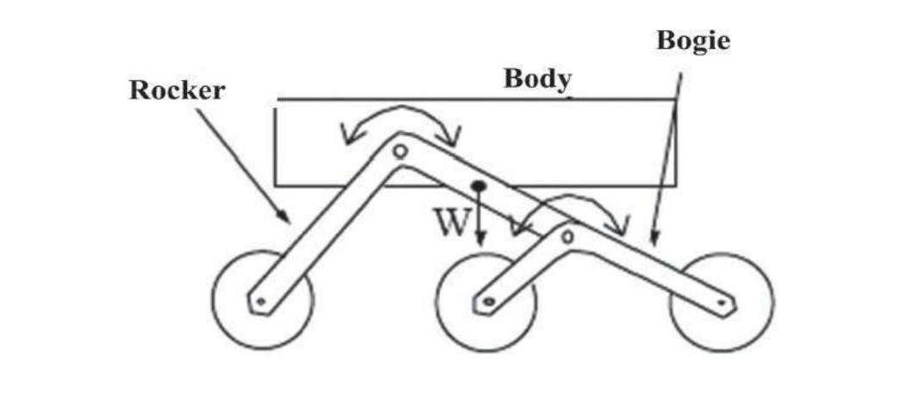
Rocker-Bogie Mechanism
The term “rocker” comes from the rocking aspect of the larger link on each side of the suspension system.
The "bogie" part of the suspension refers to the smaller linkage that pivots to the rocker in the middle and which has a drive wheel at each end.
The rocker-bogie design has no springs or stub axles for each wheel, allowing the rover to climb over obstacles, such as rocks while keeping all six wheels on the ground.
Figure-2 Rocker-Bogie mechanism

Slide 5
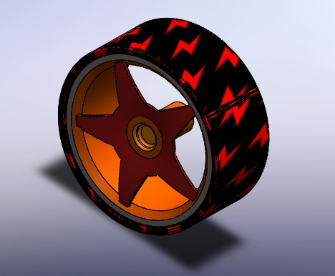
DESIGNING OF COMPONENTS
Main Components used are:
Wheels
Required speed is 9.996 cm/s i.e., 99.96 mm/s
99.96 = π D N/60
DN = 1910.06
Diameter = 40 mm, N = 47.75 rpm
Figure-3 Rover’s Wheel

Slide 6
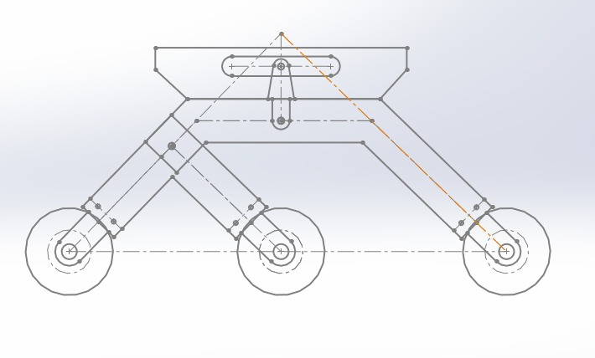
Rocker-Bogie Mechanism
Length of Rocker’s leg hinged with bogie = 27.50 mm
Length of Rocker’s leg = 70 mm
Length of Bogie legs = 61.71 mm
Length of Wheel Base = 200 mm
Net Height of RBM = 120 mm
Width of RBM = 20 mm
Figure-4 RBM Pre-design sketch

Slide 7
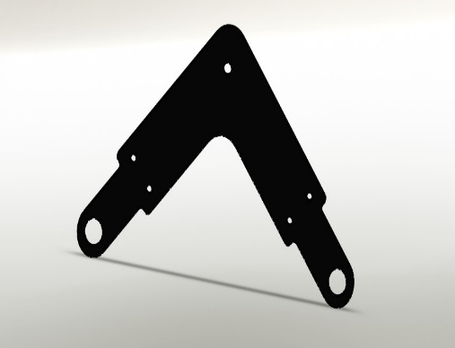
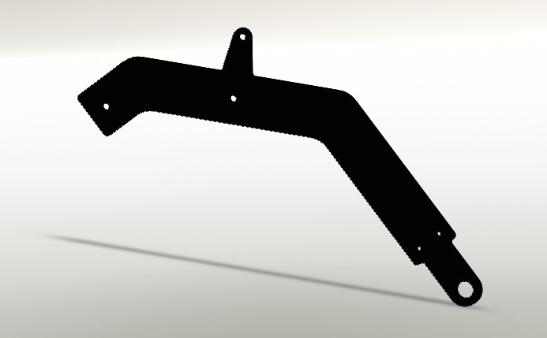
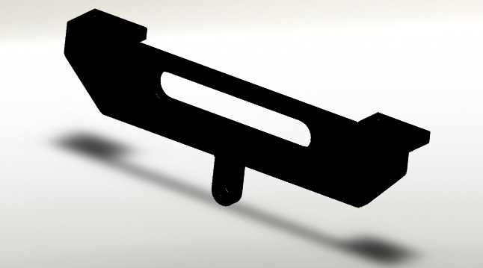
Figure-5 Rocker frame design
Figure-6 Bogie frame design
Figure-7 Planform base frame design

Slide 8
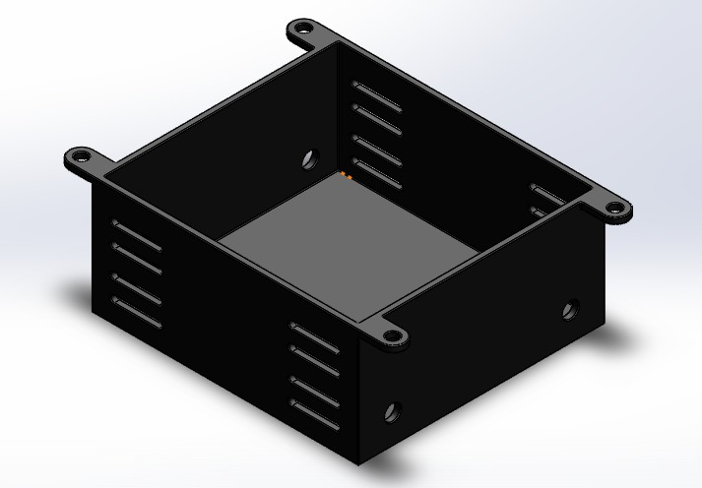
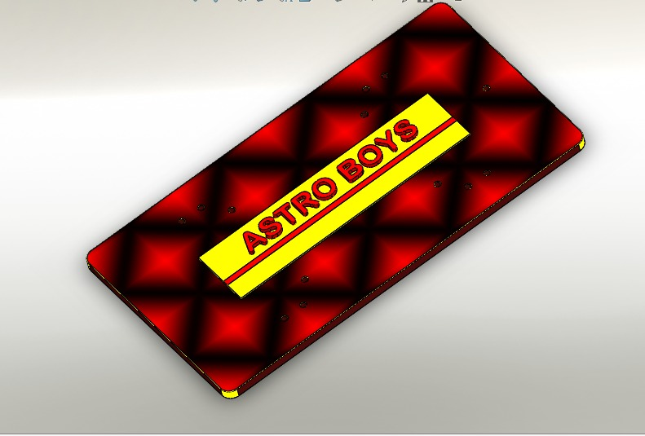
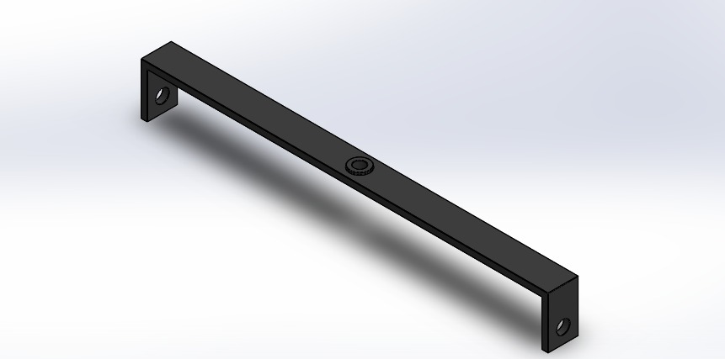
Some other components:
Figure-9 Electronic and Battery box
Figure-8 Platform
Figure-10 Differential Bar

Slide 9
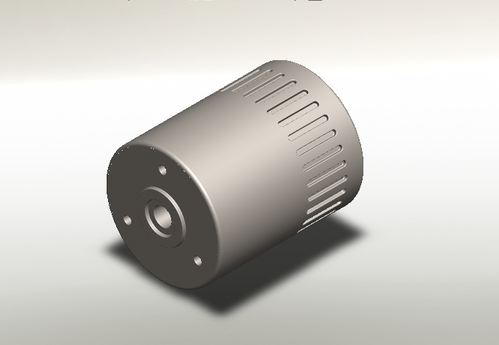
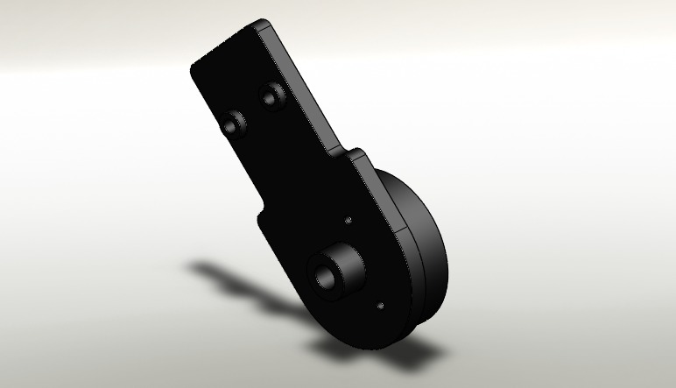
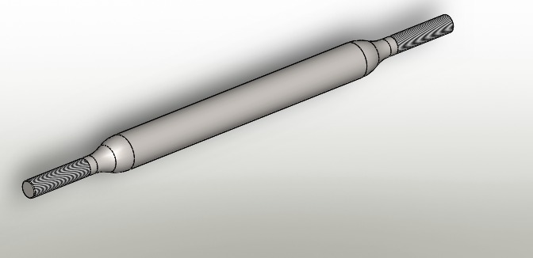
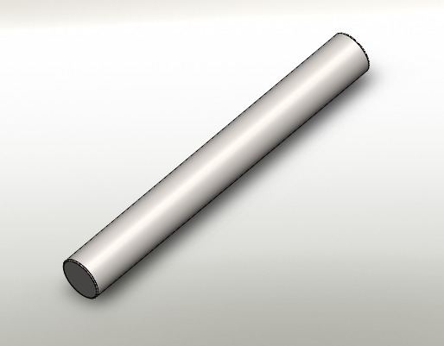
Figure-12 Motor
Figure-13 Motor Mounting Bracket
Figure-11 Tie-Rod
Figure-14 Motor Shaft

Slide 10
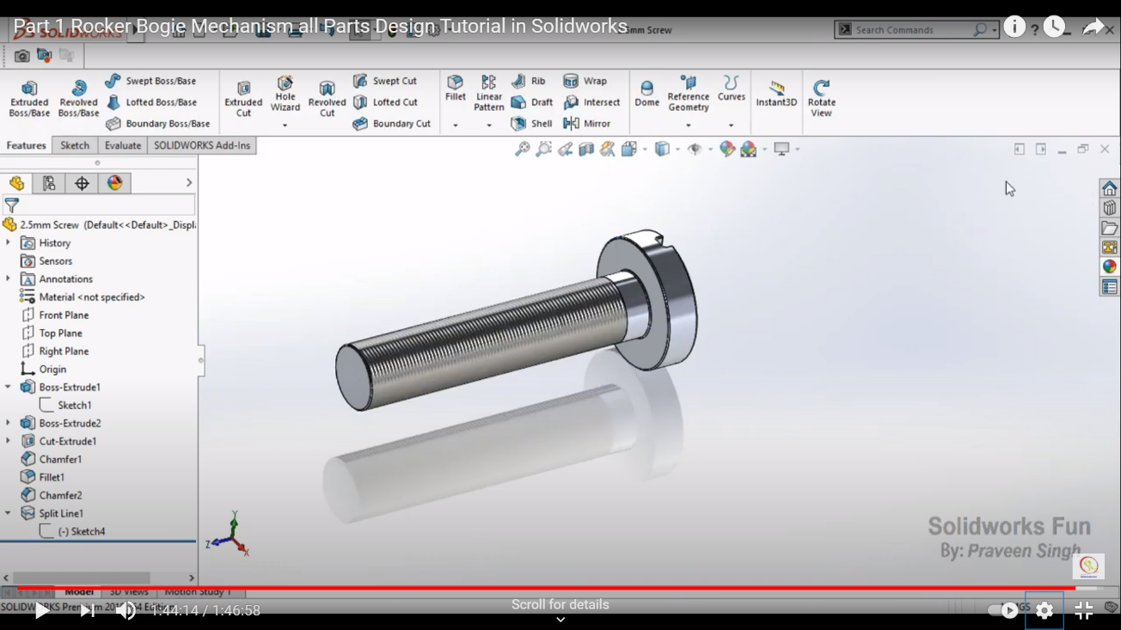
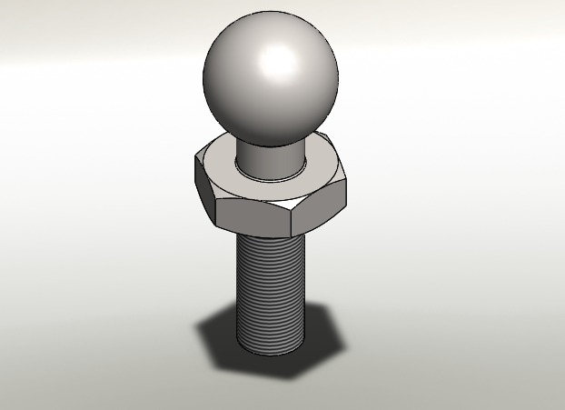
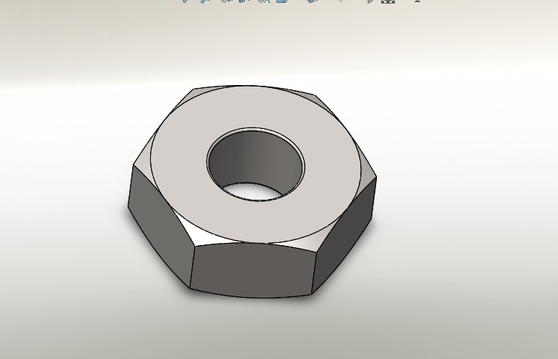
Figure-16 Bolt
Figure-15 Ball-End
Figure-17 Nut

Slide 11
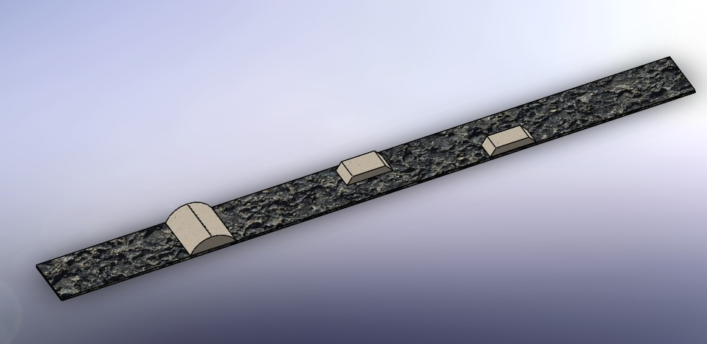
Track
Length = 2400 mm
Width = 225 mm
Figure-18 Test Track

Slide 12
Quantity of Component Used:
Component | Quantity
Wheel | 6
Rocker and Bogie | 2(each)
Tie-Rod | 2
Motor, Mounting Bracket and Shaft | 6(each)
Platform and Planform Base | 1(each)
Electronic and Battery Box | 1
Ball-End | 4

Slide 13
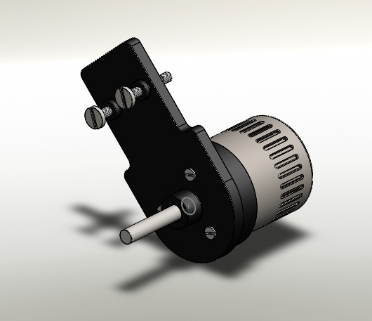
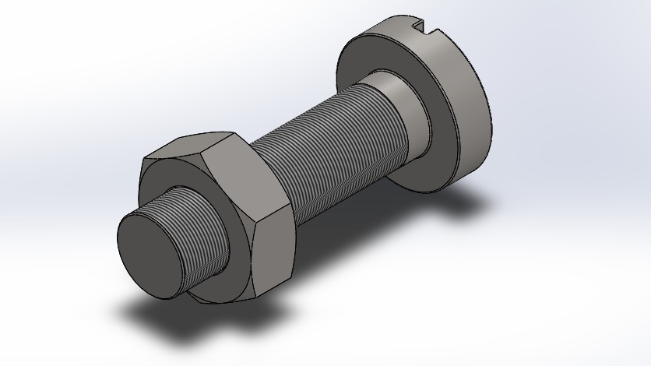
ASSEMBLY
Figure-19 Nut-Bolt Assembly
Figure-20 Motor Assembly

Slide 14
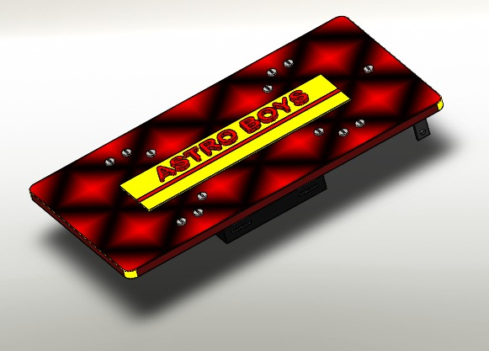
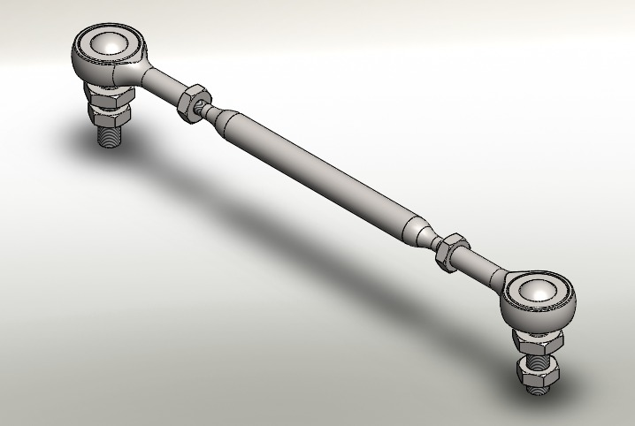
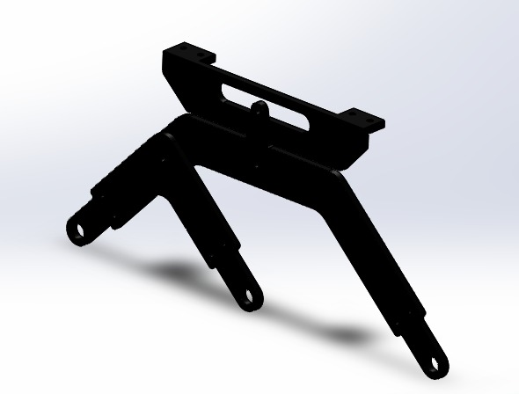
Figure-21 Planform Assembly
Figure-23 Rocker-Bogie Assembly
Figure-22 Tie-Rod Assembly

Slide 15
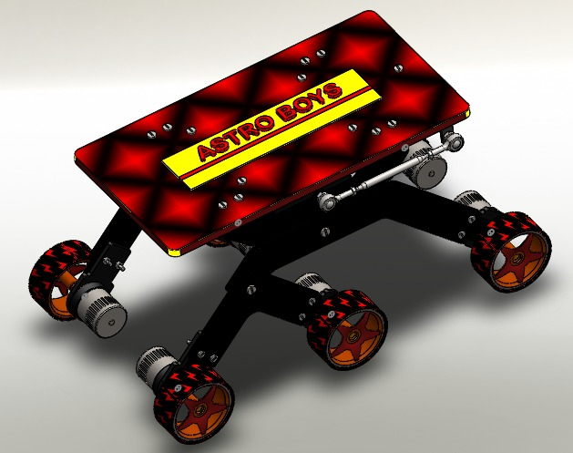
Figure-24 Final-Rover Assembly

Slide 16
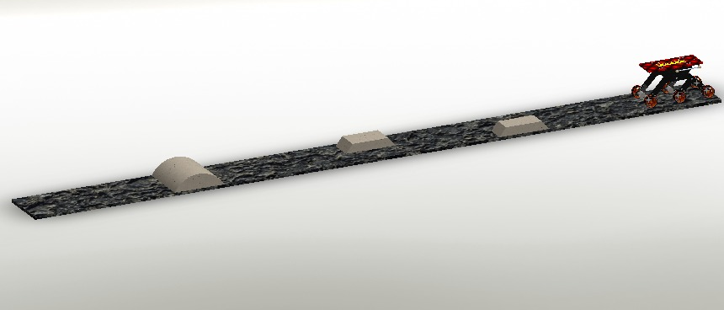
SIMULATION
Parameters used:
Gravity = 3.721 m/s²
Speed = 10 mm/s
Coefficient of kinetic friction = 0.5
Coefficient of static friction = 0.7
Figure-25 Rover-Track Setup

Slide 17
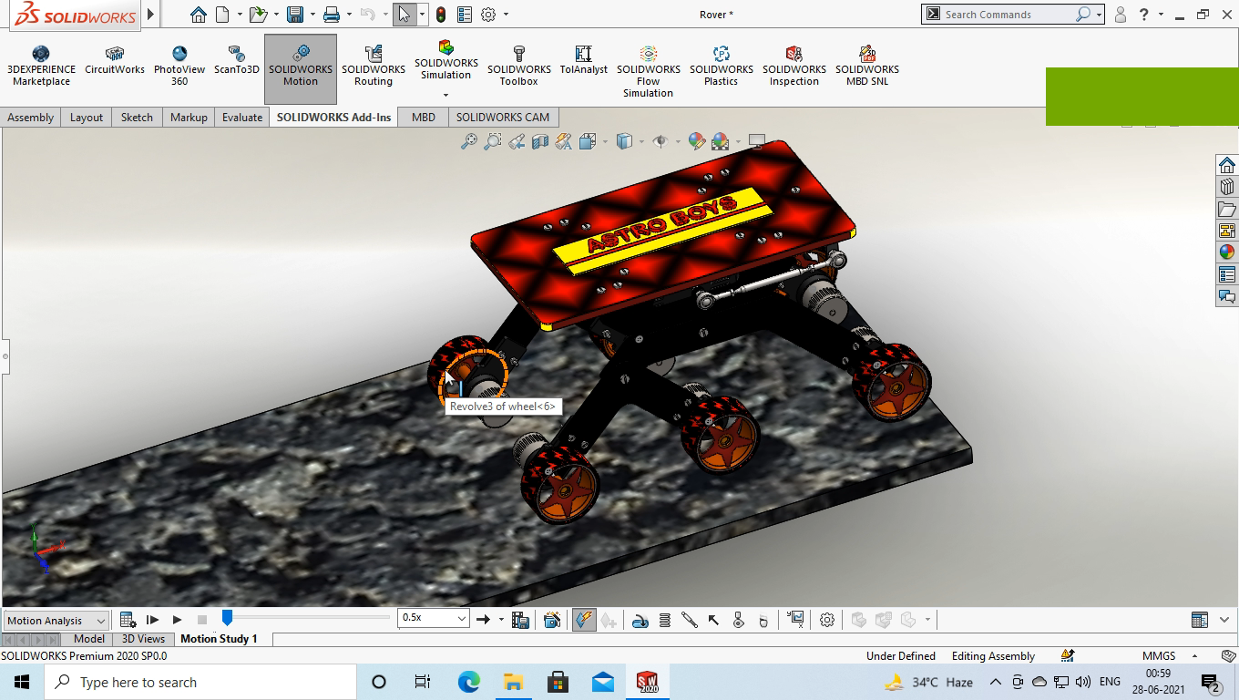

Slide 18
CONCLUSION
This project shows how the rover with a rocker-bogie system works on different surfaces. This rover has a
larger wheel as compared to obstacles; it can easily operate over most of the Martian rocks.
This design gives an increase in the stability margin and proved valuable and profitable contrasting with the
3D model simulations done in "SOLIDWORKS".
In the future, if the system is installed in heavy vehicles and conventional off-road vehicles, it will decrease
the complexity as well as power requirements. Further, development in this design will enable this mechanism
to be used for defense operation, act as a spy etc.

Slide 19
References
[1] P. Panigrahi, A. Barik, Rajneesh R. & R. K. Sahu, “Introduction of Mechanical Gear Type Steering Mechanism to Rocker Bogie”, Imperial Journal of Interdisciplinary Research (IJIR) Vol-2, Issue-5, ISSN: 2454-1362,2016.
[2] A. Bhole, S. H. Turlapati, Raja Shekhar V. S, J. Dixit, S. V. Shah, Madhava Krishna K, “Design of a Robust Stair Climbing Compliant Modular Robot to Tackle Overhang on Stairs” arXiv:1607.03077v1 [cs. RO], 11 Jul 2016.
[3] M. D. Manik, A. S. Chauhan, S. Chakraborty, V. R. Tiwari, “Experimental Analysis of climbing stairs with the rocker-bogie mechanism”, Vol-2 Issue-2 P.No. 957-960IJARIIE-ISSN(O)-2395- 4396, 2016.
[4] B. D. Harrington and C. Voorhees, “The Challenges of Designing the Rocker-Bogie Suspension for the Mars Exploration Rover”, Proceedings of the 37th Aerospace Mechanisms Symposium, Johnson Space Center, page No. 185-1985, May 19-21, 2004.
[5] Y. L. Maske, S. V. Patil, S. Deshmukh, “Modeling and MBD simulation of stairclimbing robot with rocker-bogie Mechanism”, International Journal of Innovative Research in Technology, 101743, Volume 1 Issue 12, Page no. 267-273, ISSN: 2349-6002, 2015.
[6] N. Yadav, B. Bhardwaj, S. Bhardwaj, “Design analysis of Rocker Bogie Suspension System and Access the possibility to implement in Front Loading Vehicles”, IOSR Journal of Mechanical and Civil Engineering, e-ISSN: 2278-1684,p-ISSN: 2320-334X, Volume 12, Issue 3 Ver. III, PP 64-67, May - Jun. 2015.
[7] "Rover Wheels". Mars Exploration Rovers: Mission. NASA. Retrieved 29 March 2019Rovers: Mission. NASA. Retrieved 29 March 2019

Slide 20
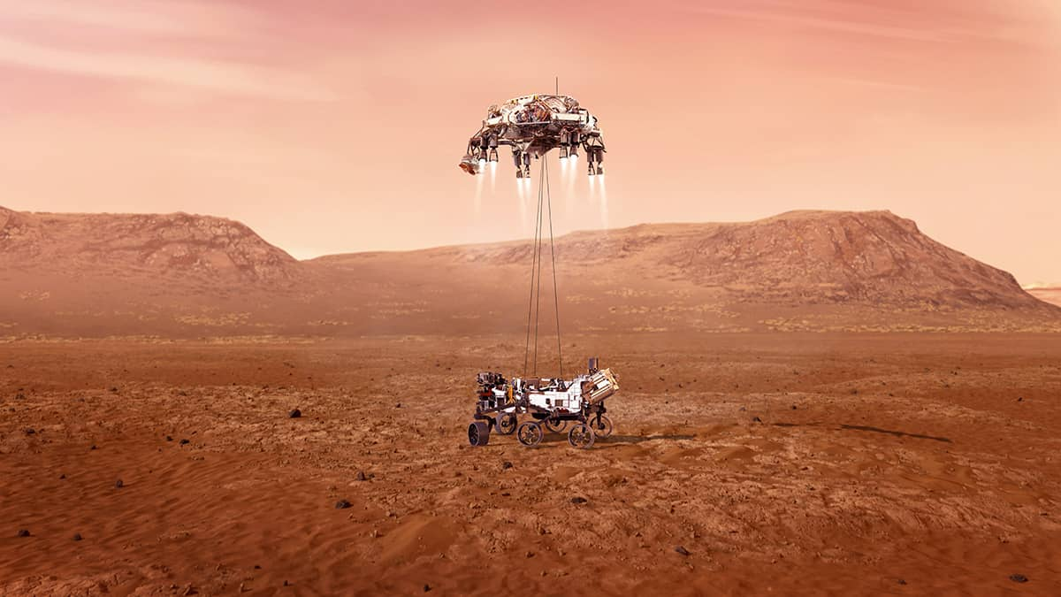
THANK YOU

